Slide 1
Coursera Capstone Project: Applied Data Science
Kristof Domokos Szabo
Budapest, Hungary
2020.04.26

Slide 2
Overview
Introduction
Problem Statement
Data
Methodology
Results
Discussion
Conclusion

Slide 3
Introduction
According to Statista, the United States restaurant industry generated a staggering 745.61 billion USD in sales during 2018.
The average household spending on eating out was 4400 USD a year across the United States.
In this hypothetical project a group of Hungarian investors are looking into opening up a Hungarian Fine dining restaurant in one of the major cities around the United States.

Slide 4
Problem Statement
Hungary is a relatively small country of 10 million, its brand and cuisine is relatively unknown in the United States.
Which major city would make sense to open the first restaurant, considering the boost it could receive from population of Hungarian ancestry?

Slide 5
Data
Several data sources have been used in the project, including:
Venue data extracted trough Foursquare API
Supporting data scraped from numerous websites using BeautifulSoup
GeoJSON for visualizing results around the potential locations

Slide 6
Methodology
The first phase of this research principally relies on scraped web data, which determined the primary location for opening up the restaurant.
In the second phase of the research, Foursquare API is used to collect venue data, firstly to identify competition and potential customer base for the restaurant.
In the third phase, potential boroughs in the city are explored where the restaurant could be opened, using Pandas dataframe and Foursquare API.

Slide 7
Results – First Phase
The author of this Notebook works on the assumption that cities with a sizeable Hungarian-American population and Hungarian venues will be more likely to convert to customers for the restaurant.
In order to support this, states with a sizeable Hungarian diaspora have been extracted. These numbers have been paired with economic information and overall population sizes to better support understanding.

Slide 8
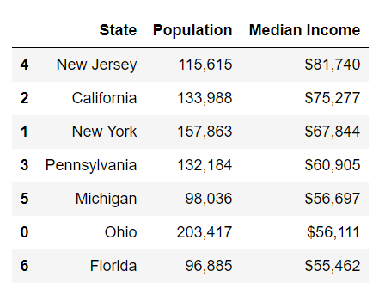
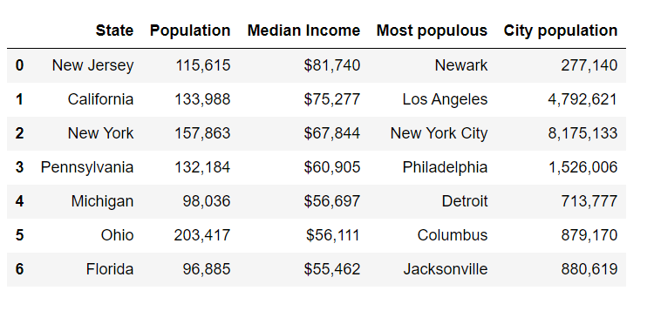
Results – First Phase

Slide 9
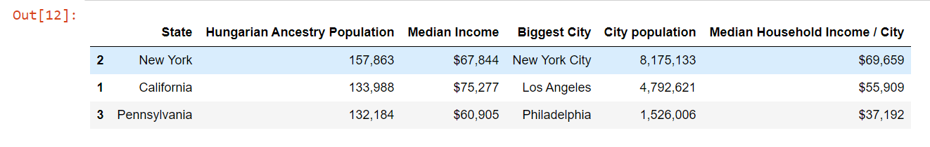
Results – First Phase
The potential location has been determined by choosing the city with the biggest population (potential customer base), economic strength and relative size of Hungarian-American population.

Slide 10
Results – Second Phase
In the second phase of the research, venue data has been pulled and segmented in order to understand how Hungarian restaurants and Hungarian venues are distributed in New York.
On one hand, a high density of Hungarian restaurants are not favored because of competition.
On the other hand, proximity of Hungarian venues is crucial, as it can be a foundation for customer base.

Slide 11
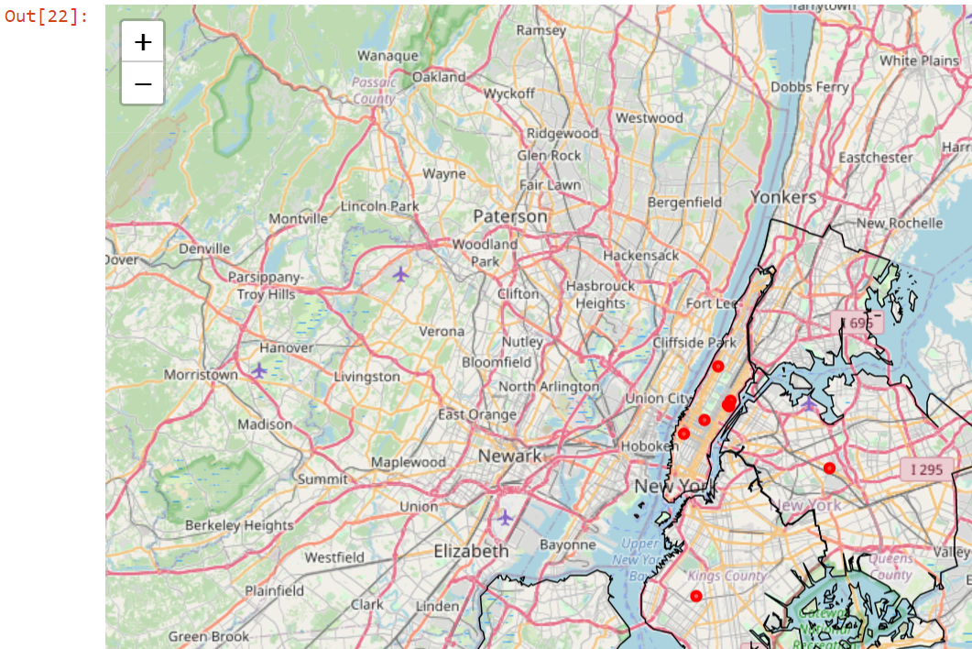
Results – Second Phase
When visualized on a folium map, analysis has shown that the majority of Hungarian restaurants are in Manhattan.

Slide 12
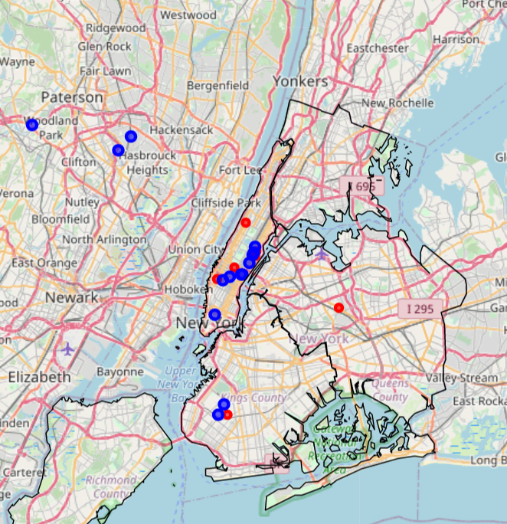
Results – Second Phase
Furthermore, the majority of Hungarian venues are also in Manhattan.

Slide 13
Results – Second Phase
Based on this, the recommendation is to open a restaurant in close proximity to those venues outside of the Manhattan borough.

Slide 14
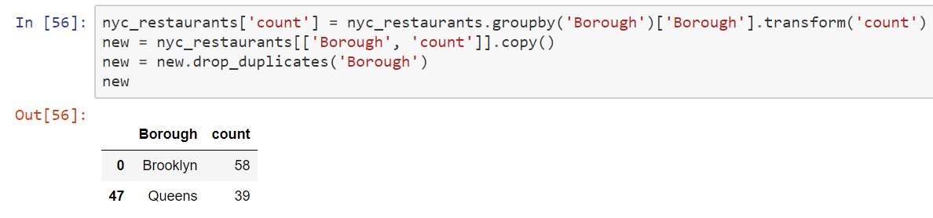
Results – Third phase
In the third phase of the research, venue data has been pulled from the close proximity of Manhattan, Queens and Brooklyn.
The total count of restaurants in these boroughs have been assesed and visualized on a map.

Slide 15
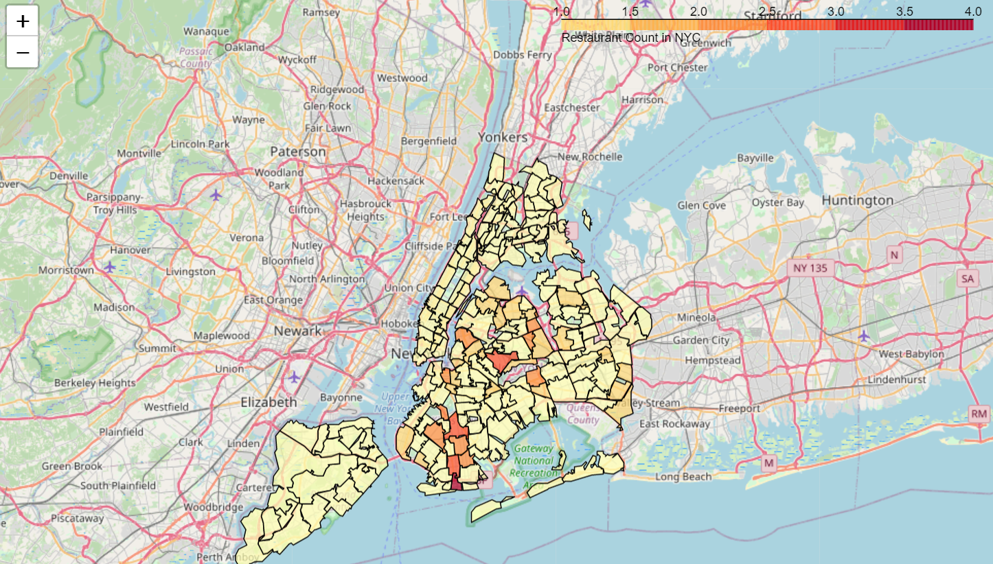
Results – Third phase
In the third phase of the research, venue data has been pulled from the close proximity of Manhattan, Queens and Brooklyn.
The total count of restaurants in these boroughs have been assesed and visualized on a map.

Slide 16
Results – Third phase
Analysis has concluded that none of the neighborhoods in Brooklyn and Queens have more than 4 restaurants.

Slide 17
Discussion and Conclusion
The scope of this project was to determine the right location opening a new Hungarian restaurant in the United States. After thorough analysis, it has been determined that New York is an ideal location for such venue.
Competition analysis has shown that most Hungarian venues and restaurants are located in Manhattan, and some of the neighboring boroughs have been targeted for further analysis.
Analysis of Brooklyn and Queens have shown that none of their neighborhoods have a large density of restaurants.
The author recommends to carry out further on-field research in Brookly and Queens to determine the location for the venue.

